Slide 1
PSG Institute of Technology and Applied Research, Coimbatore
TripSync: A Unified Platform for Trip Planning and Management
Team Members
Arthi R ( 715522104006)
Mahesh K (715522104032)
Sanjeeve Sankar S (715522104047)
Dr R. Manimegalai
1

Slide 2
Introduction to Trip Planning and Management
Group travel requires detailed planning and dynamic coordination
  Traditional travel planning methods are fragmented and inefficient.
TripSync is proposed as a comprehensive travel management solution
  integrates itinerary planning, expense tracking, chat, and GPS tracking
  enhances safety with real-time location tracking and automated alerts when participants move out of a designated range
  focuses on individual functionalities
‹#›

Slide 3
Literature Survey
Williams R., Gupta M. “AI-Based Travel Recommendation System Using User Preferences” Journal of Smart Tourism, 2022.
Problem Solved | The lack of personalized travel recommendations based on user preferences and budget constraints.
Proposed Solution | A deep learning-based recommendation engine using user preferences and AI-driven suggestions.
Results | Increased travel satisfaction by 50% and improved travel experience through real-time itinerary updates.
Merits | Enhanced personalization and improved cost-effectiveness of trips for travelers.
Demerits | High dependency on data availability and accuracy of user-provided preferences.
Future Work | Implement an AI chatbot for real-time assistance and instant itinerary adjustments.
‹#›

Slide 4
Literature Survey
John Doe, Jane Smith "AI-Based Route Optimization for Group Travel," International Journal of Smart Travel Technologies, 2022.
Problem Solved | Inefficient trip planning and real-time route optimization, leading to delays in group travel.
Proposed Solution | Machine learning algorithms and real-time traffic data to optimize travel routes.
Results | Improved travel time by 35% and minimized detours through real-time updates.
Merits | Optimized travel efficiency by reducing delays and traffic congestion, improving time management.
Demerits | The system requires continuous GPS Tracking,leading to the potential privacy concerns.
Future Work | Integrate weather forecasting and public transport tracking for better predictions.
‹#›
Notes:
‹#›

Slide 5
Literature Survey
Chen L., Patel V. “Blockchain-Based Security Framework for Online Travel Booking Platforms,” International Journal of Cybersecurity, 2023.
Problem Solved | Security threats such as data breaches, payment fraud, and identity theft in online travel platforms.
Proposed Solution | Utilizing blockchain technology for decentralized and transparent travel booking transactions.
Results | Increased trust and security in digital travel transactions while reducing fraudulent activities.
Merits | Enhanced data integrity, transparency, and reduction of middlemen costs in travel bookings.
Demerits | High computational cost and slow transaction speeds due to blockchain technology limitations.
Future Work | Explore smart contracts for automatic refunds and integration with AI-based fraud detection models.
‹#›

Slide 6
Gaps Identified
Fragmentation
  Existing travel apps specialize in isolated features such as itinerary planning or expense management but lack an integrated solution
Inefficient Coordination
  Manual coordination using messaging apps often leads to confusion
Limited Safety Features
  Most travel apps do not offer real-time tracking or geofencing alerts to prevent individuals from getting lost
Lack of Real-Time Expense Sharing
  Many expense-tracking applications require manual inputs and do not sync dynamically with group members.
Coordinating group-travel is challenging task
  Miscommunication, schedules, and unclear expense tracking
  Existing solutions address specific needs, but none provide a holistic, unified platform
‹#›

Slide 7
Problem Statement and Objectives
TripSync is developed to provide an integrated and holistic solution
  Providing a single trip room for all communication and coordination
  Automating expense sharing and tracking.
  Offering live location tracking and geofencing for safety
  Enabling real-time chat, announcements, and voting mechanisms.
Objectives
  To develop an unified mobile application that consolidates trip planning, expense management, and real-time communication into a single platform
  To Implement real-time location tracking to provide safety and security features through geofencing
  To enhance group decision-making through a voting mechanism integrated into trip discussions
  To optimize app performance and scalability using cloud, ensuring smooth operation for large groups
‹#›

Slide 8
TechStack used for Implementation of TripSync
Flutter (Dart) - Frontend
Firebase Cloud - Firebase Authentication, Firebase FireStore
Map API - OpenStreetMap for security and Geofencing
Weather API - to provide weather details to participants
GeoLocator - to implement Geofencing

Slide 9
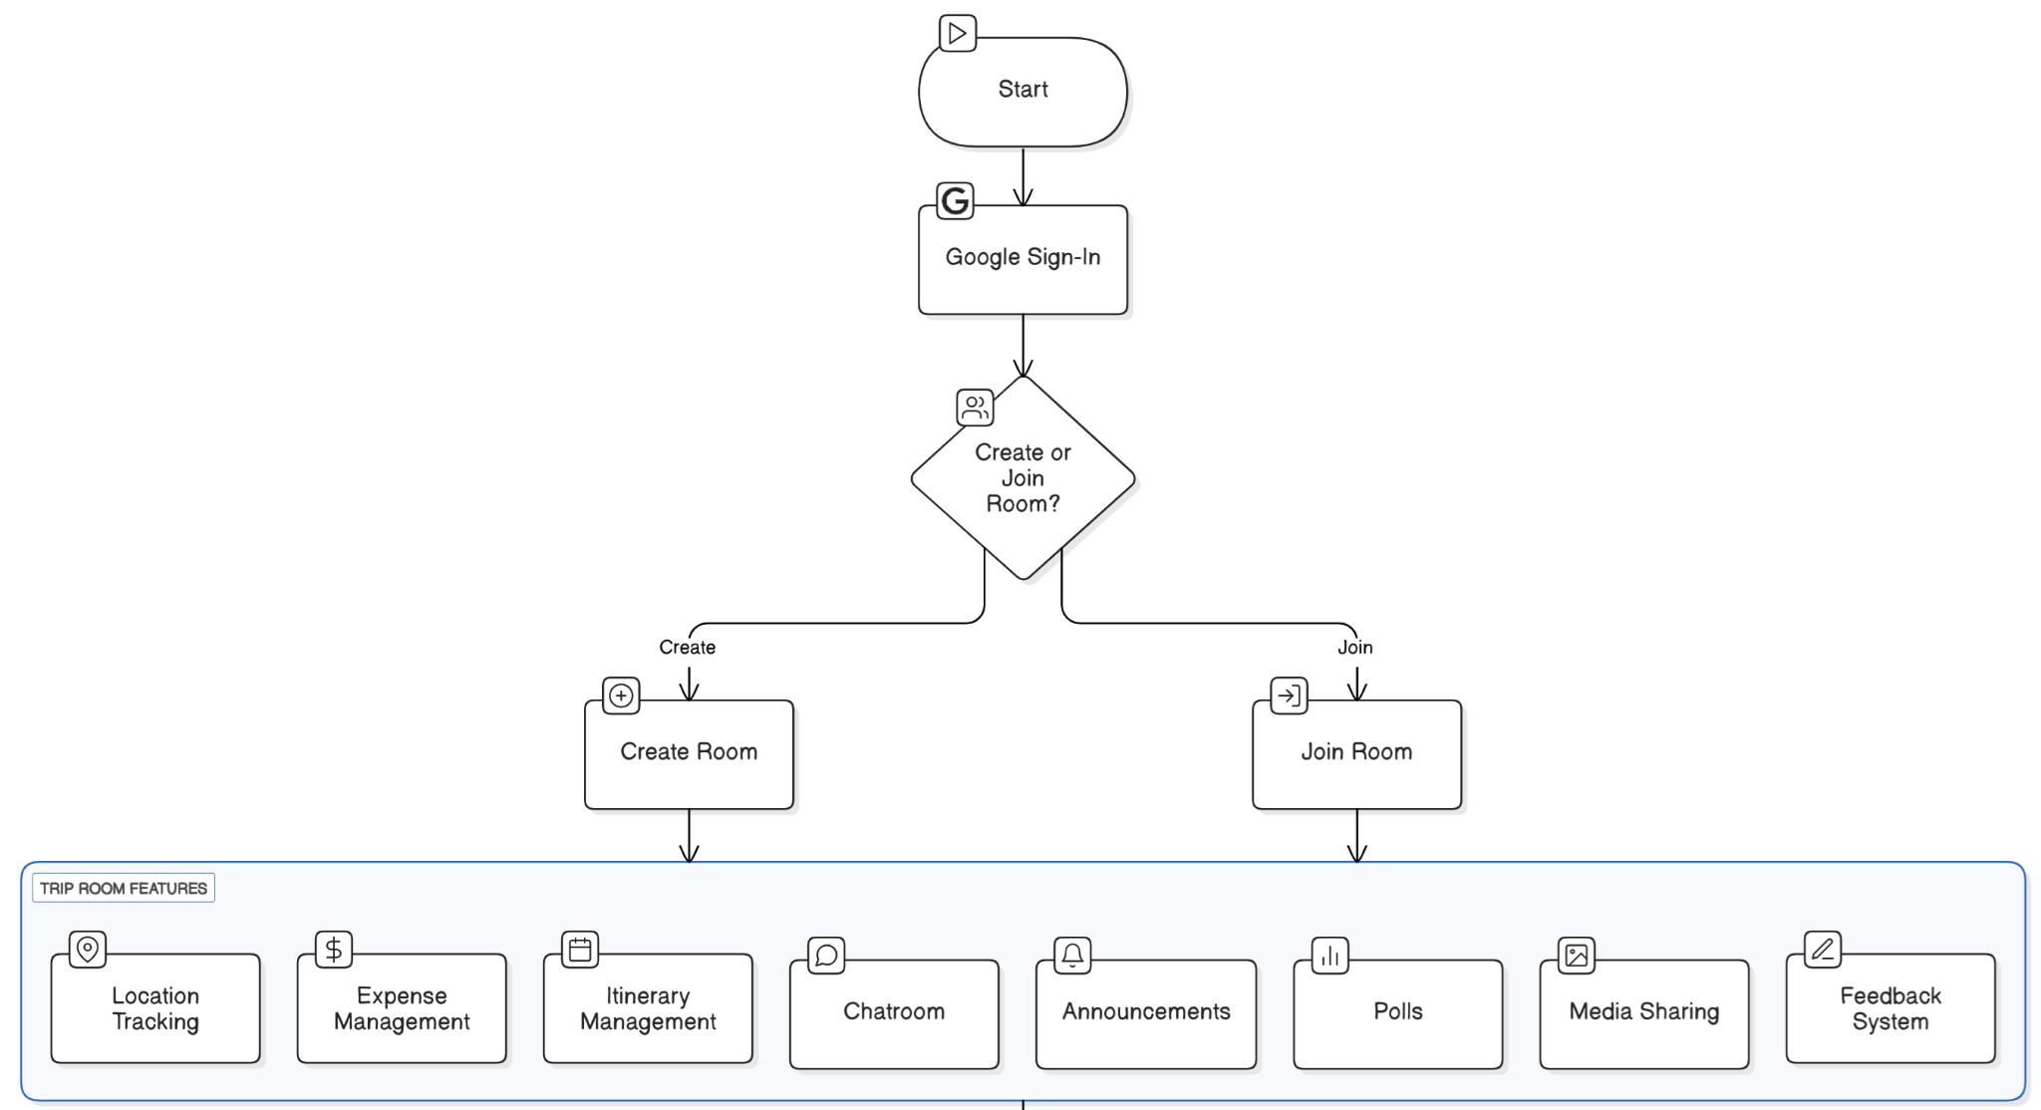
Methodology to Implement TripSync
‹#›

Slide 10
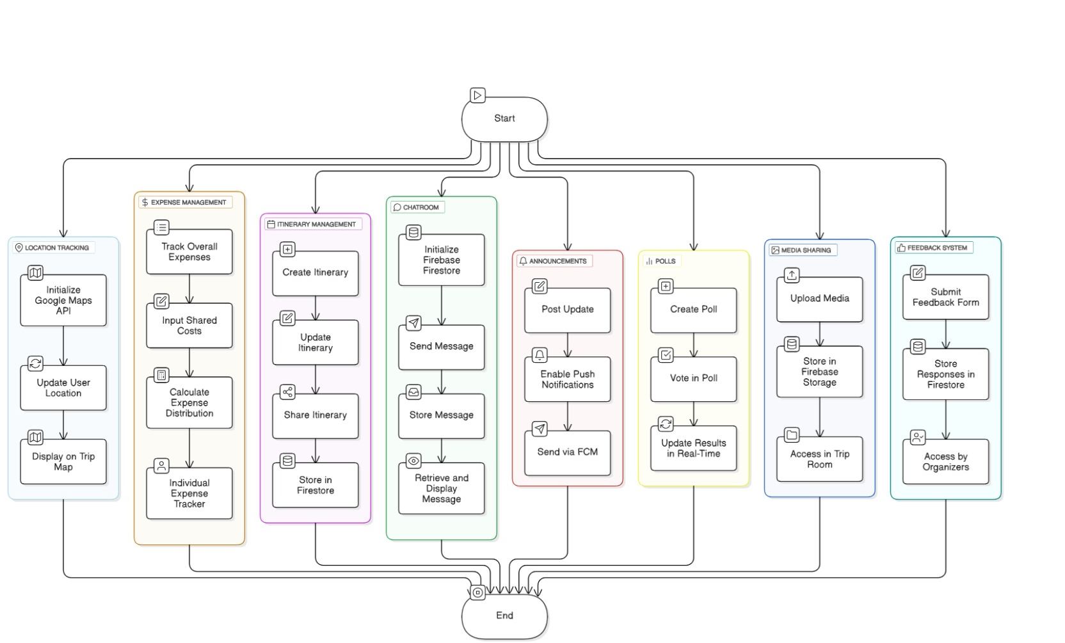
Details of Modules Implemented in TripSync Management

Slide 11
Trip Management Module
Trip Rooms
One of the core functionalities of TripSync is the ability to create and manage Trip Rooms. This feature enables trip organizers to establish dedicated virtual spaces where participants can join, collaborate, and access important trip-related information. It ensures that all members stay connected and informed throughout the trip, eliminating confusion and miscommunication.
Key Features of Trip Rooms:
Create and Join Trips: Organizers can create trip rooms, and participants can join using unique access codes.
Assign Co-Organizers: Organizers have the authority to assign co-organizers to assist in managing the trip. This ensures efficient delegation of responsibilities and seamless trip coordination.
Real-Time Updates: Any changes in the itinerary, expenses, or announcements are instantly updated for all trip members, keeping them informed throughout the journey.
‹#›

Slide 12
Itinerary Planner Module
Itinerary Planner allows organizers to create and share detailed trip schedules with all participants. It provides a structured plan for activities, helping to eliminate confusion and ensure everyone is on the same page.
Key Features:
Detailed Schedules: Organizers can create day-to-day itineraries, including event descriptions, locations, and timings.
Real-Time Modifications: Unlike traditional itinerary tools, TripSync’s planner is dynamic, allowing changes even while the trip is ongoing. Participants get instant updates on any schedule modifications.
Enhanced Coordination: By ensuring every participant has access to the latest itinerary, this feature eliminates confusion and keeps everyone informed about the planned activities and timings.
‹#›

Slide 13
Integrated Chatroom and Communication Tools
Communication is an essential aspect of successful trip coordination. TripSync offers a built-in chatroom to facilitate seamless communication among group members.
Key Features:
Dedicated Chatroom: Unlike third-party messaging apps, TripSync’s chatroom is exclusively designed for trip-related conversations, ensuring all important discussions stay in one place
Announcements Feature: Organizers can post important trip updates, last-minute changes, reminders, and emergency messages using a dedicated announcement section
Polling System: Organizers and members can create polls for group decisions. This feature allows participants to vote on crucial trip aspects such as preferred destinations, meal choices, and activity preferences
‹#›

Slide 14
Expense Management Module t
Managing shared expenses can often lead to disputes among trip participants. TripSync simplifies this process with its automated expense tracker, ensuring transparency and fair cost distribution.
Key Features:
Automated Expense Tracker: Users can input expenses, specify contributors, and receive instant cost-sharing calculations.
Expense Categorization: Participants can log personal spending and categorize expenses such as food, travel, accommodation, and activities.
Shared Expenses Management: This feature has two modes:
  Organizer Mode: Organizers can enter shared expenses and assign payments to specific participants. At the end of the trip, the app calculates individual balances and suggests optimal reimbursements to ensure fair cost-sharing.
  Personal Expense Tracker: Each participant can track their personal expenses, monitor spending habits, and keep a detailed record of their contributions during the trip.
‹#›
*

Slide 15
Security and Location Tracking
Ensuring the safety and security of all participants is a key priority for TripSync. The app offers multiple tracking and security features that enhance user safety during travel.
Key Features:
Real-Time Location Tracking: Participants can view the live location of their group members. This is particularly useful for outdoor activities, adventure trips, or crowded locations where people might get separated
Manual Location Sharing: Users have the option to share their location when needed, ensuring privacy while still allowing for quick assistance in emergencies
Customizable Alerts: Organizers can set a custom radius for location alerts. If a participant moves beyond this radius, an immediate notification is sent to the group, allowing quick response in case of emergencies.
‹#›

Slide 16
Shared Media Repository Module
TripSync includes a shared media repository where participants can upload and access trip-related content such as photos, videos, and documents.
Key Features:
Centralized Storage: All media files are stored in a single, accessible location, eliminating the need for scattered file-sharing platforms.
Organized Media Library: Users can categorize photos and videos based on the day or event, making content easy to find.
Enhanced Collaboration: Participants can upload, view, and share their trip experiences, fostering better engagement among group members.
‹#›

Slide 17
Feedback System
The Feedback System allows trip participants to share their experiences, helping organizers improve future trips.
Key Features:
Private Feedback to Organizers: Participants can submit their feedback, which is visible only to the trip organizers.
Structured Rating System: The system includes a rating scale and an optional section for written comments to provide deeper insights.
Trip Improvement Insights: Organizers can review feedback to identify strengths and areas for improvement, ensuring better trip experiences in the future.
‹#›

Slide 18
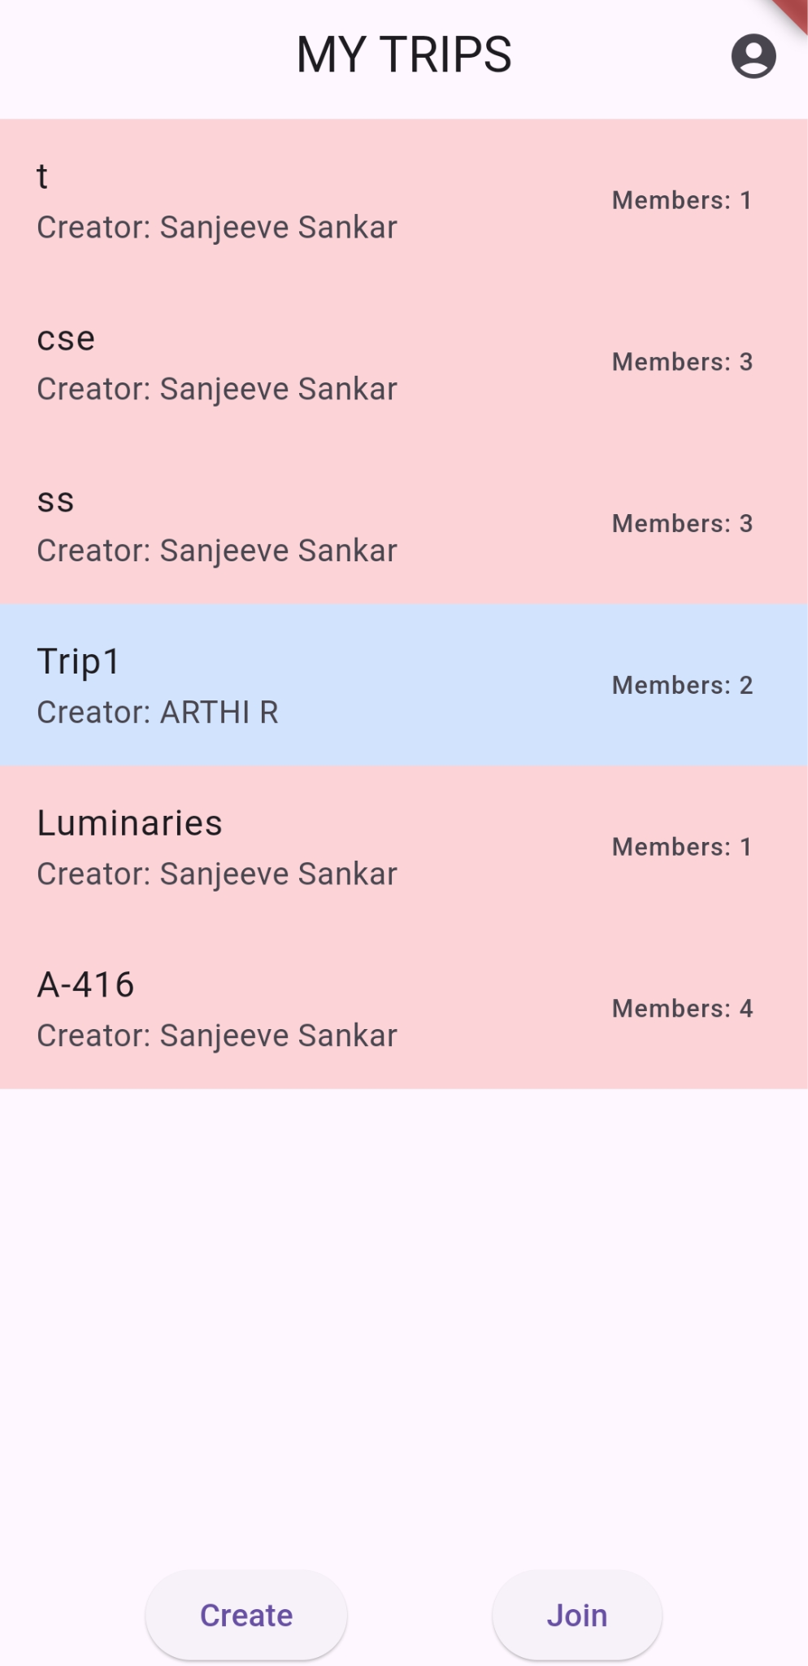
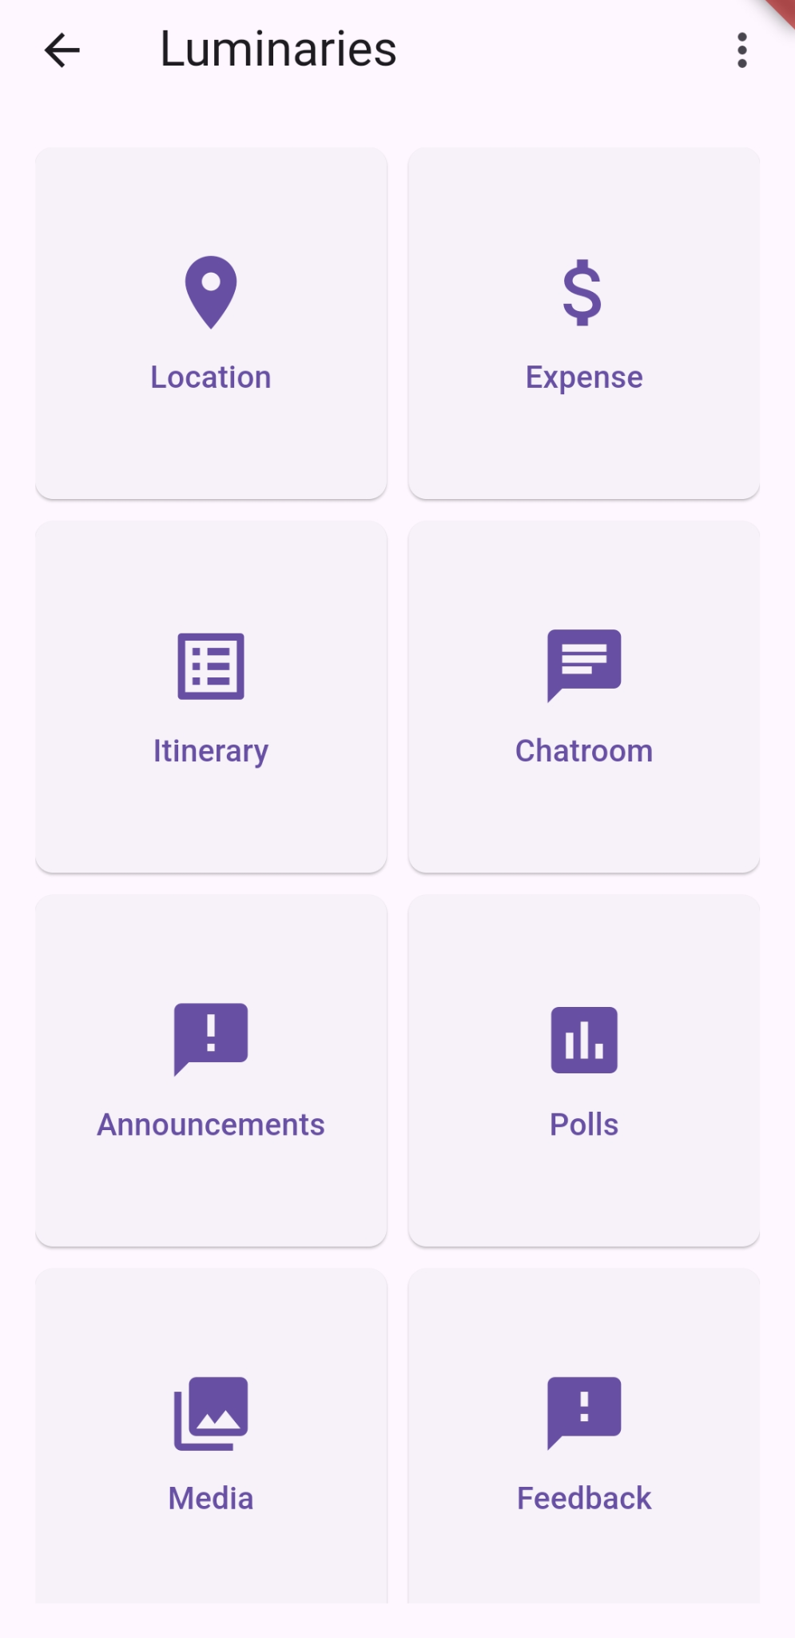
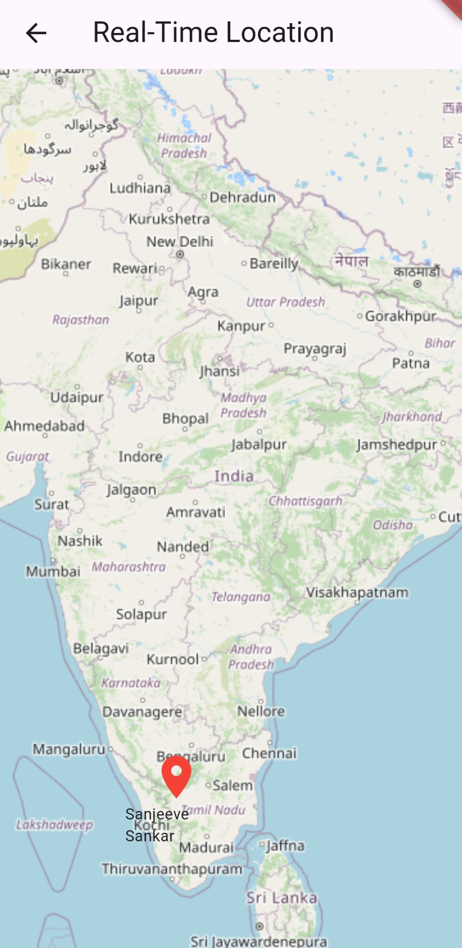
Screenshots of TripSync Modules
‹#›

Slide 19
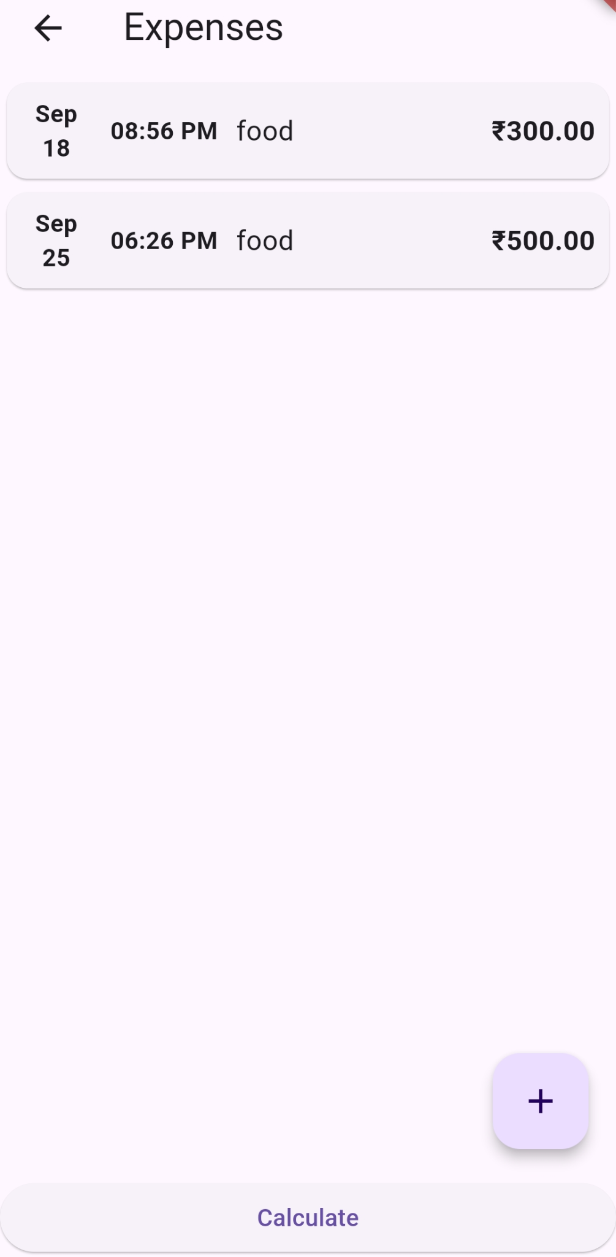
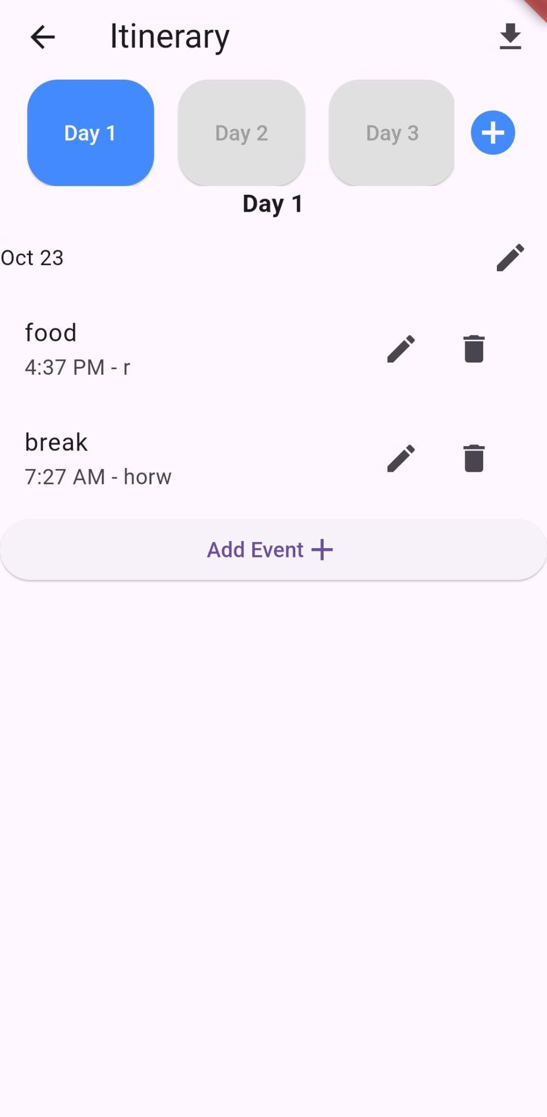
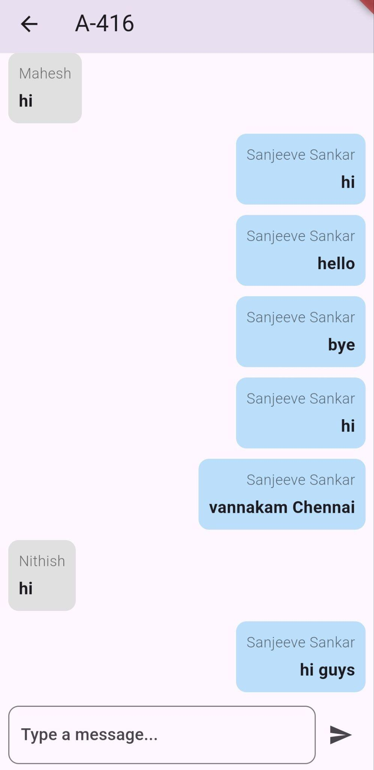
Screenshots of TripSync Modules
‹#›

Slide 20
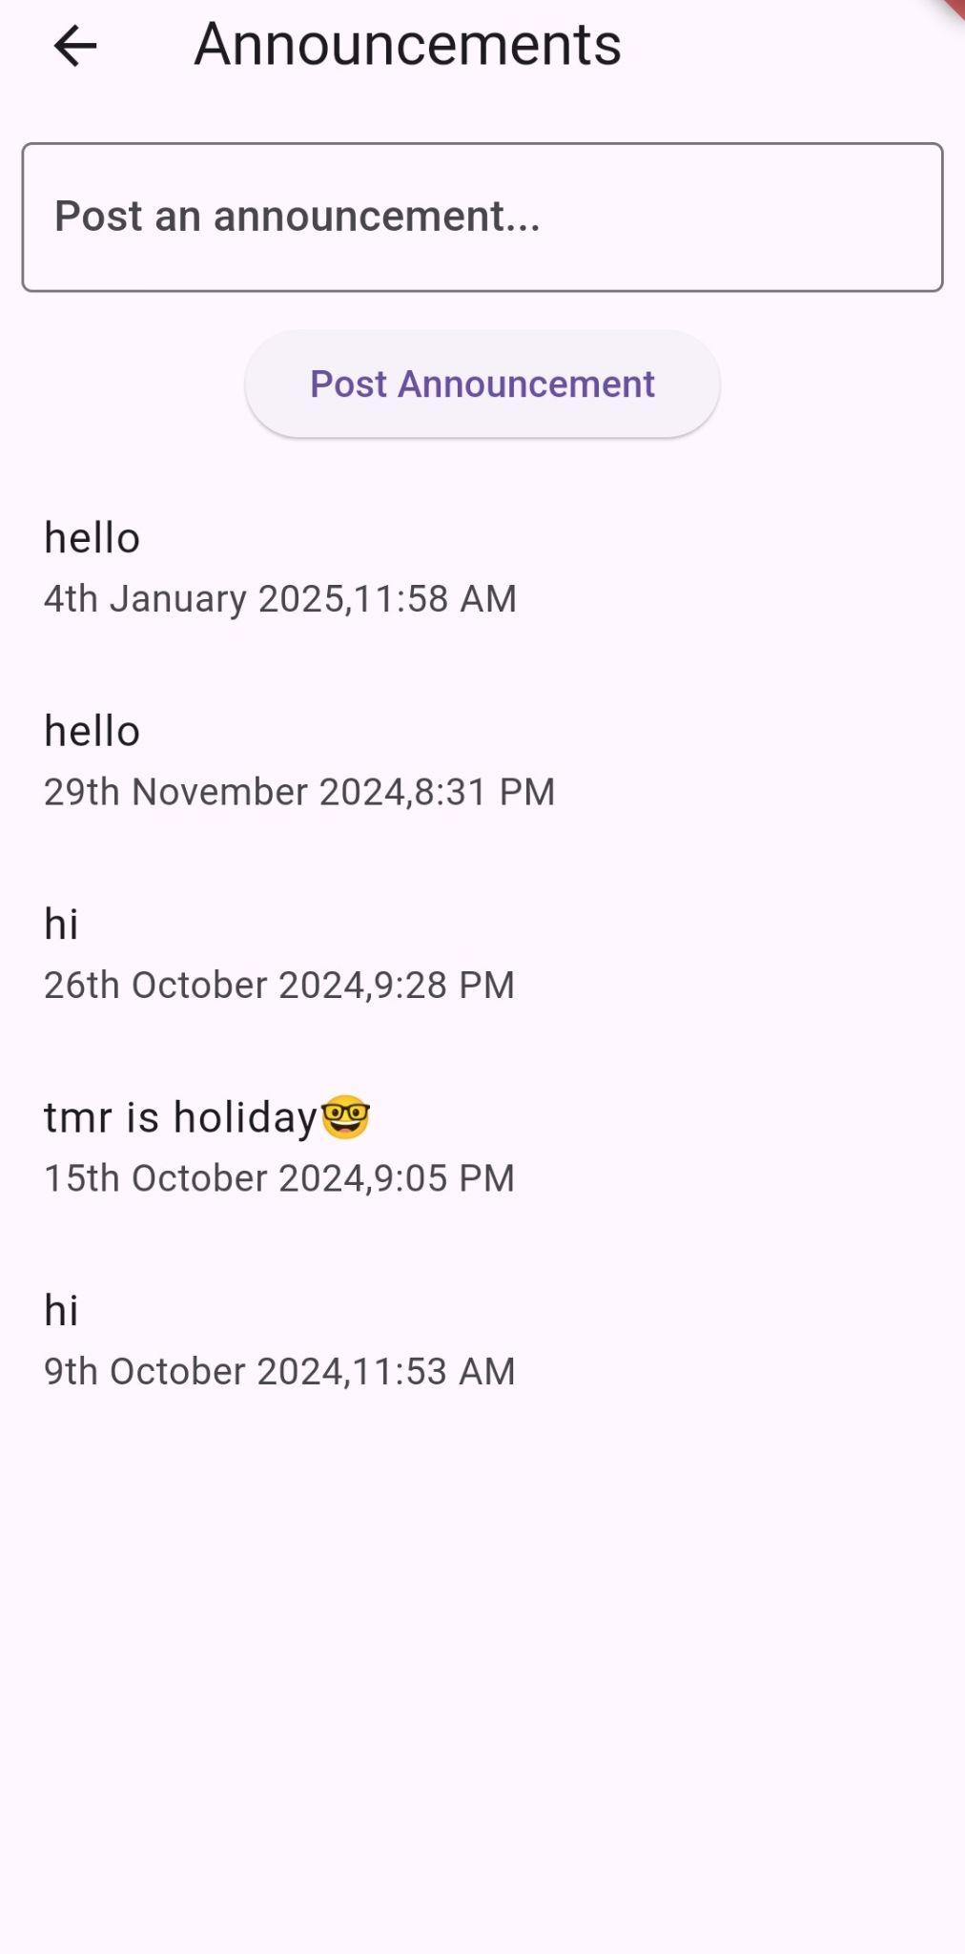
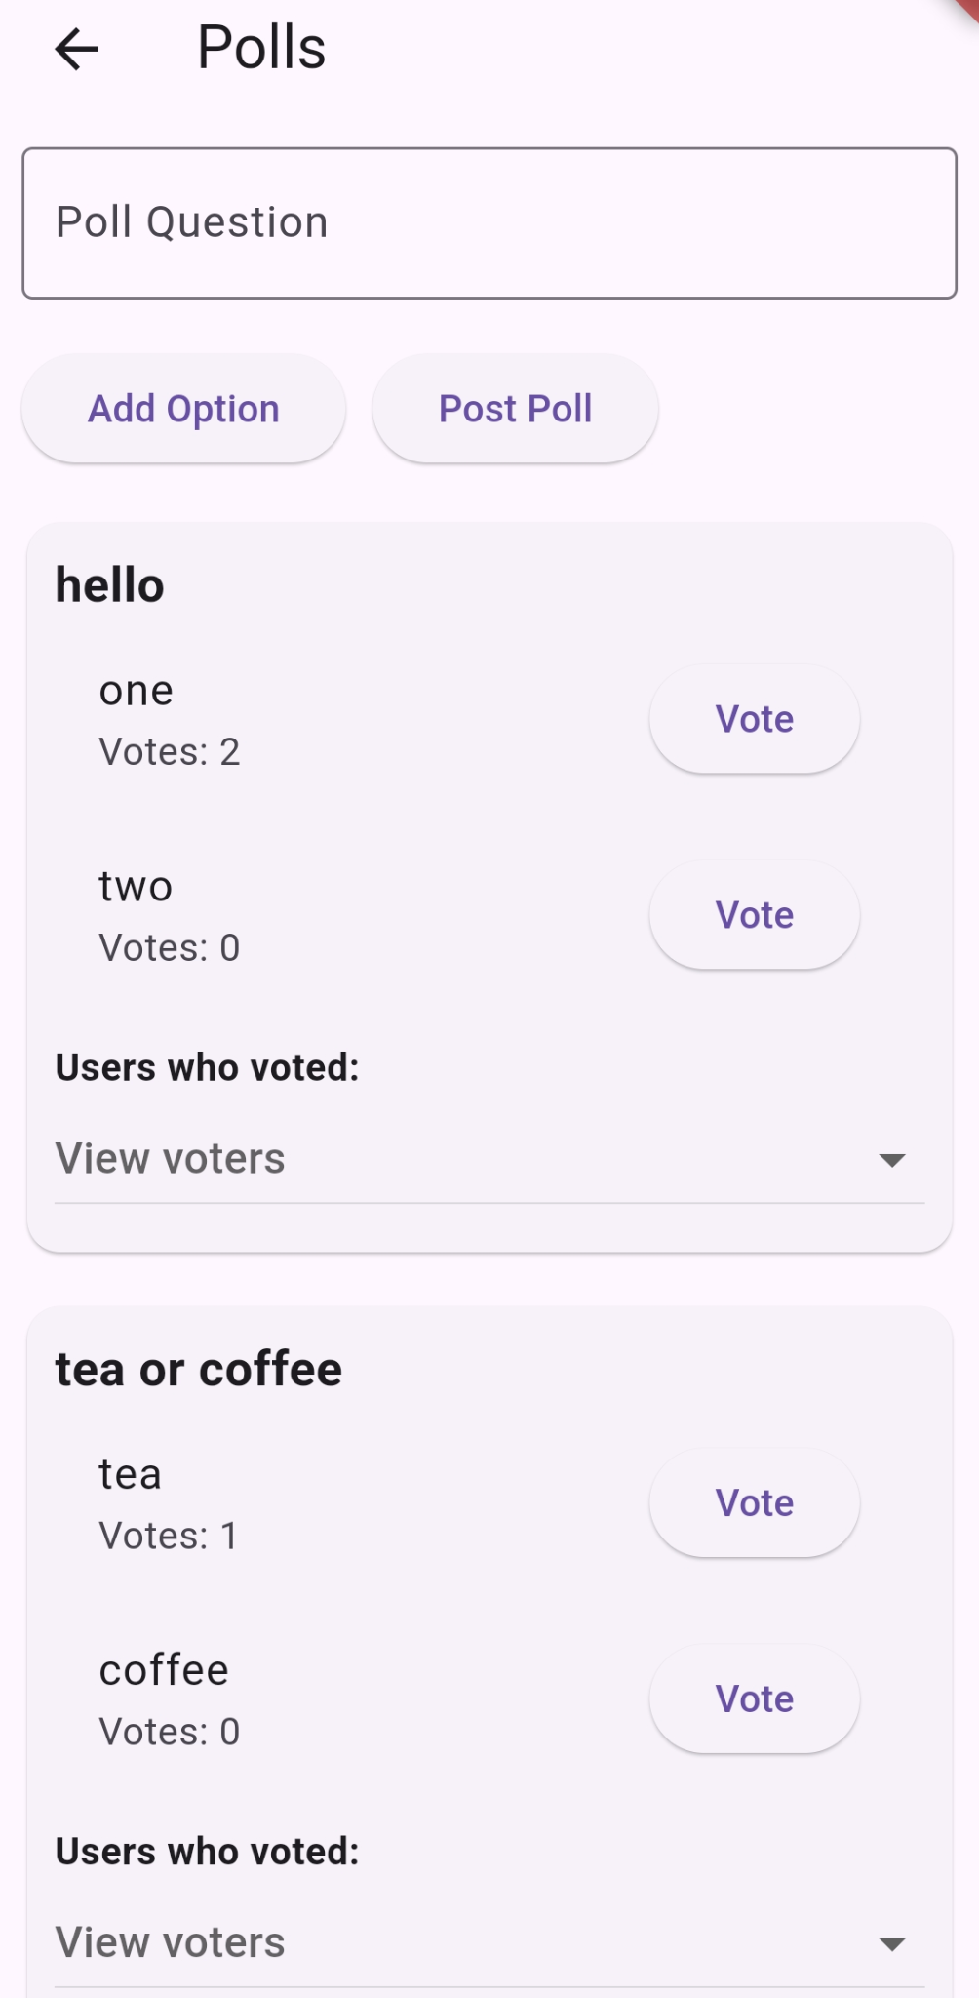

Screenshots of TripSync Modules
‹#›

Slide 21
Conclusions and Future Work
Conclusions:
TripSync is an all-in-one travel management app
Simplifies group travel experiences
Integrates itinerary planning, real-time communication, and expense tracking
Offers safety monitoring and data sharing features through Geofencing
Ensures organized, secure, and hassle-free travel coordination
Future Work:
AI-powered Itinerary Recommendations
Machine Learning for Expense Predictions
AI-powered Security Enhancements: Fraud detection, emergency SOS alerts, and integration with local emergency services
Direct Partnerships with Travel Services: Enabling flight, hotel, and rental bookings directly within the app

Slide 22
Roles and Responsibilities
Itinerary Planner, FeedBack System,Trip Room Creation : Arthi R
Expense management,Location,Firebase Services : Mahesh K
Chatroom, Announcements, Polls, Shared Media : Sanjeeve Sankar S
Integration of all modules and testing : All Three

Slide 23
References
[1] S. W. Rahate and M. Z. Shaikh, ”Geo-fencing Infrastructure: Location Based Ser-
vice,” in *Proceedings of [Conference Name]*, [Year], pp. [Page Numbers].
[2] A. H. Abbas, M. I. Habelalmateen, S. Jurdi, L. Audah, and N. A. M. Alduais, ”GPS Based Location Monitoring System with Geo-fencing Capabilities,”. AIP Conf. Proc. 2173, 020014 (2019)
[3] Nurul Idayu Binti Yunus, & Syerina Azlin Md Nasir. (2023). Development of E-Travel Mobile Application Using Geofencing Technique. Applied Mathematics and Computational Intelligence (AMCI), 12(2), 15–27.
[4] V. A., A. Mayan J., N. P., and R. Francis, ”Expense Manager Application,” Technical Report.
[5] Surekha, S. et al. (2022). Android Application for Business Expense Management. In: Balas, V.E., Solanki, V.K., Kumar, R. (eds) Recent Advances in Internet of Things and Machine Learning. Intelligent Systems Reference Library, vol 215. Springer, Cham.
‹#›

Slide 24
Thank You!
Questions?
‹#›

Slide 25
Thank You!

